Slide 1
Lean Mean, Yearbook Machine
Working Smart with a Small Staff
Tony Cane
Weaver High School
Hartford, CT

Slide 2


Before we begin, respond to the following survey
https://docs.google.com/forms/d/e/1FAIpQLSfqZe9cHDP6BJQ5tbMUX8IhFIpjrKFqIPn0glW9pMzy2JHHTg/viewform?usp=dialog

Slide 3
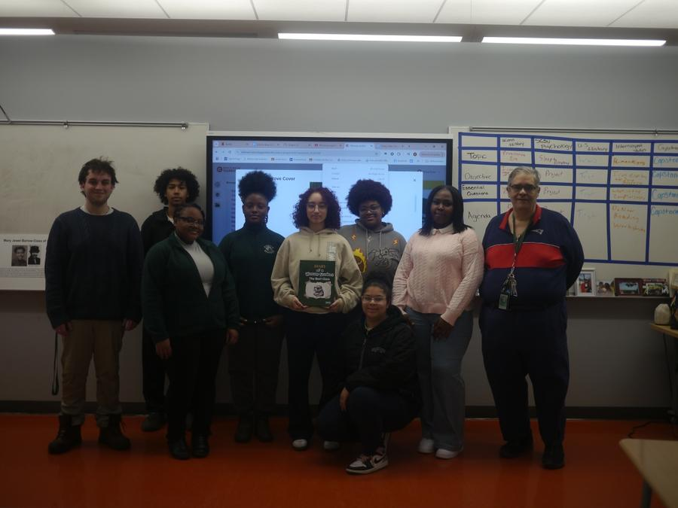
2025 Weaver Yearbook Club at its peak

Slide 4
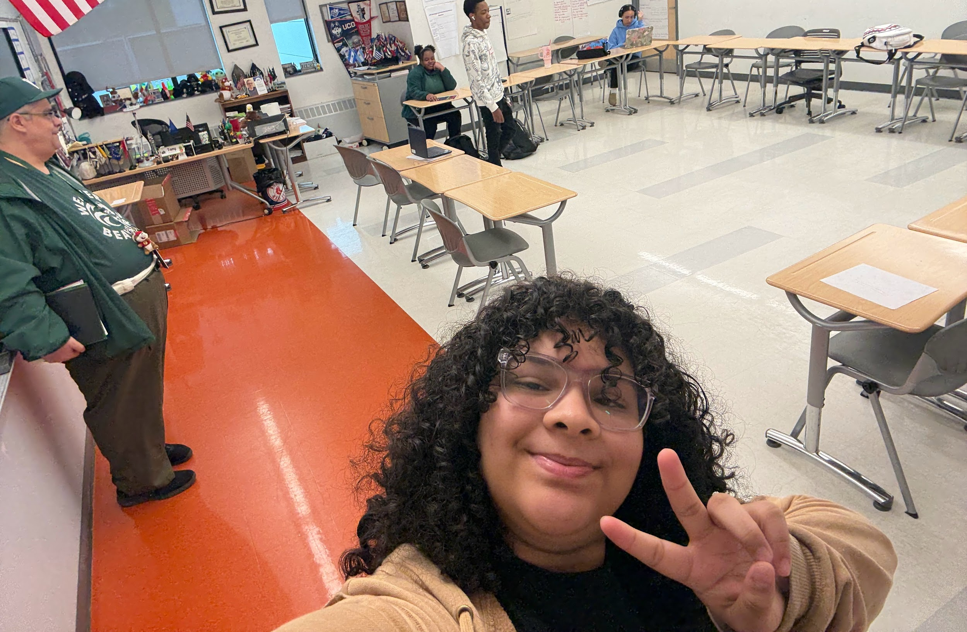
Yearbook Room on Normal Days
Most days just a core few
The Few but proud
Sessions every 2 weeks
45 minutes each session

Slide 5
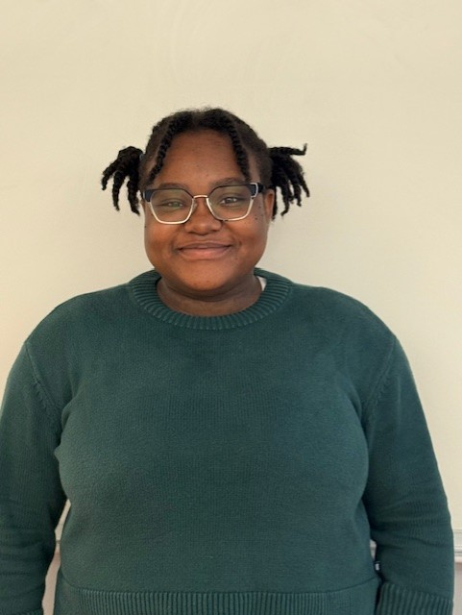
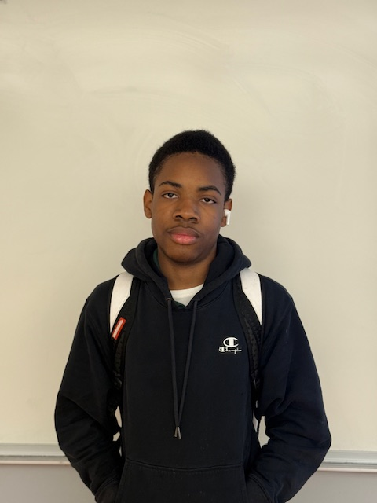
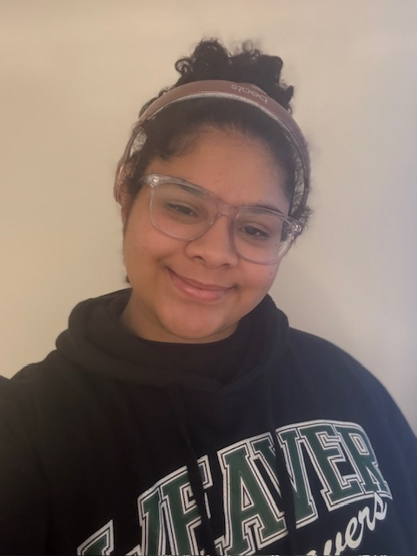
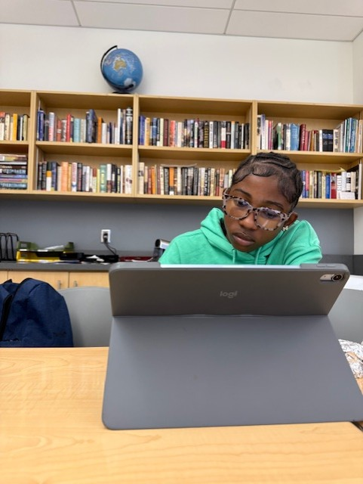
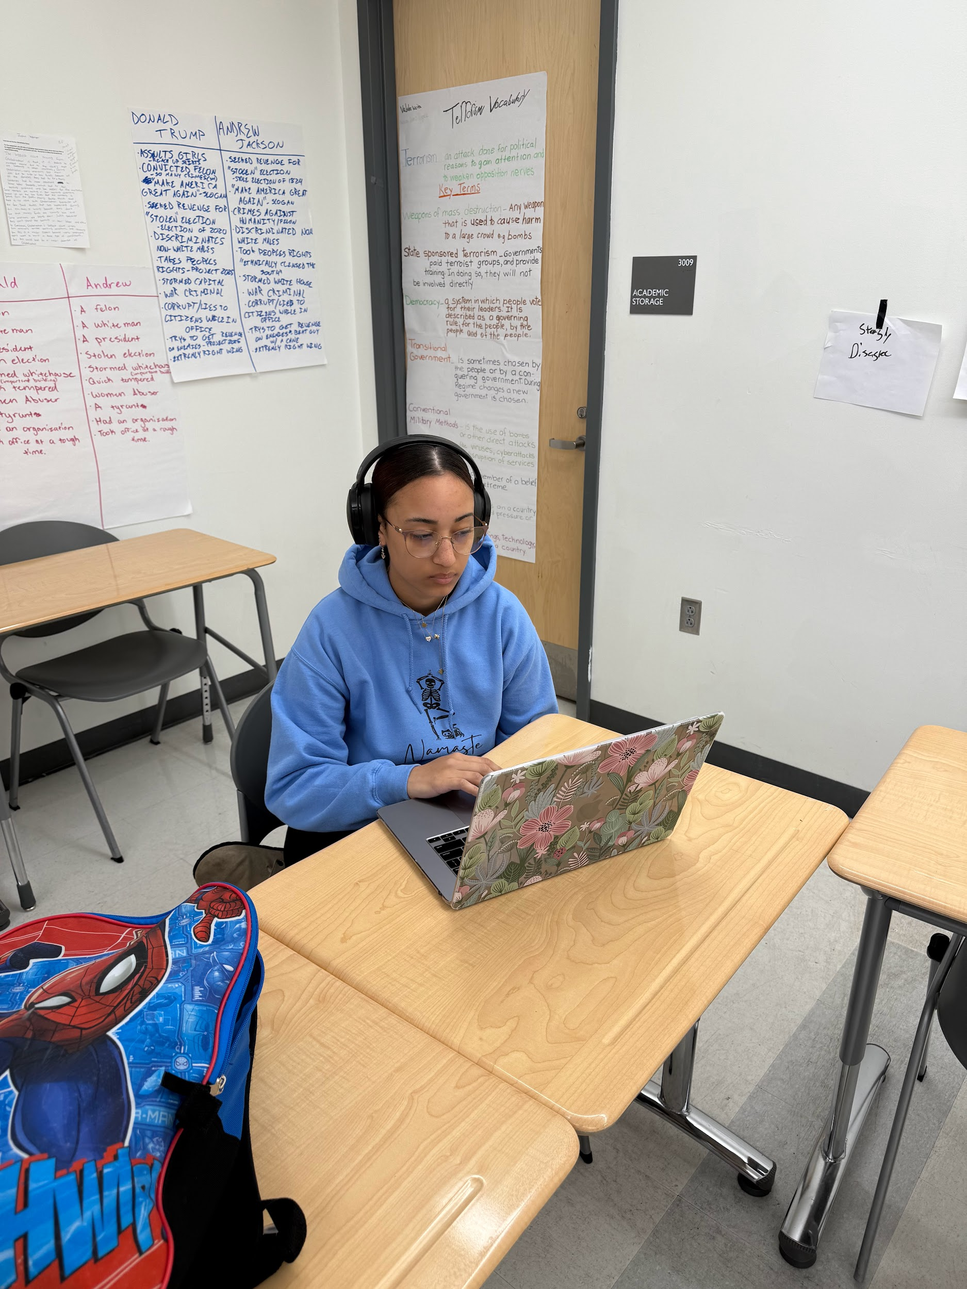
The Core Crew
Vanity-President
Shantana-Editor
Kevina-Writer
Adriana-Chief Photographer
Andre-Sales & Marketing
That’s it!

Slide 6
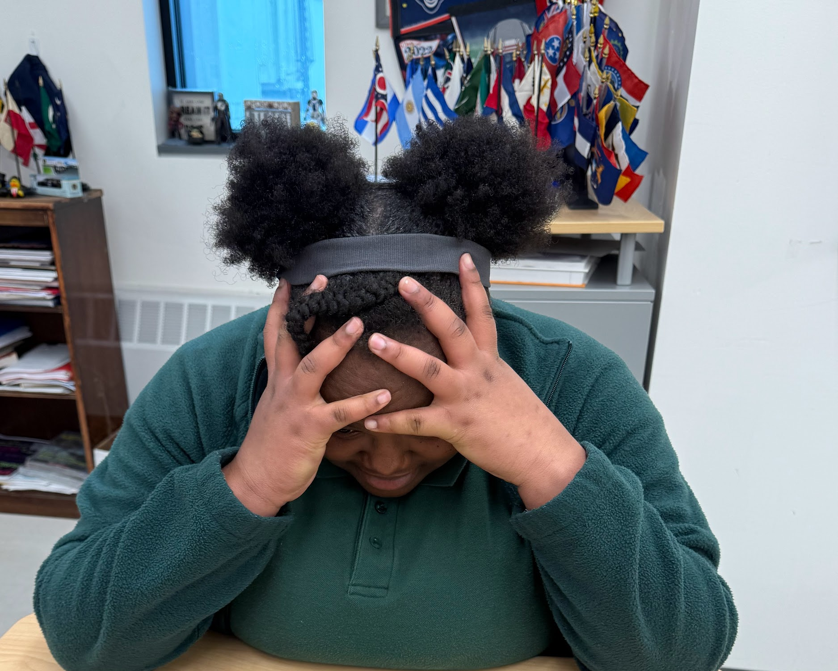
Problems with a small team
Work tends to fall on one or two people
Communication issues
Personality conflicts
Pressure to meet deadlines
Tears can flow
Easy to miss things because of no fresh eyes

Slide 7
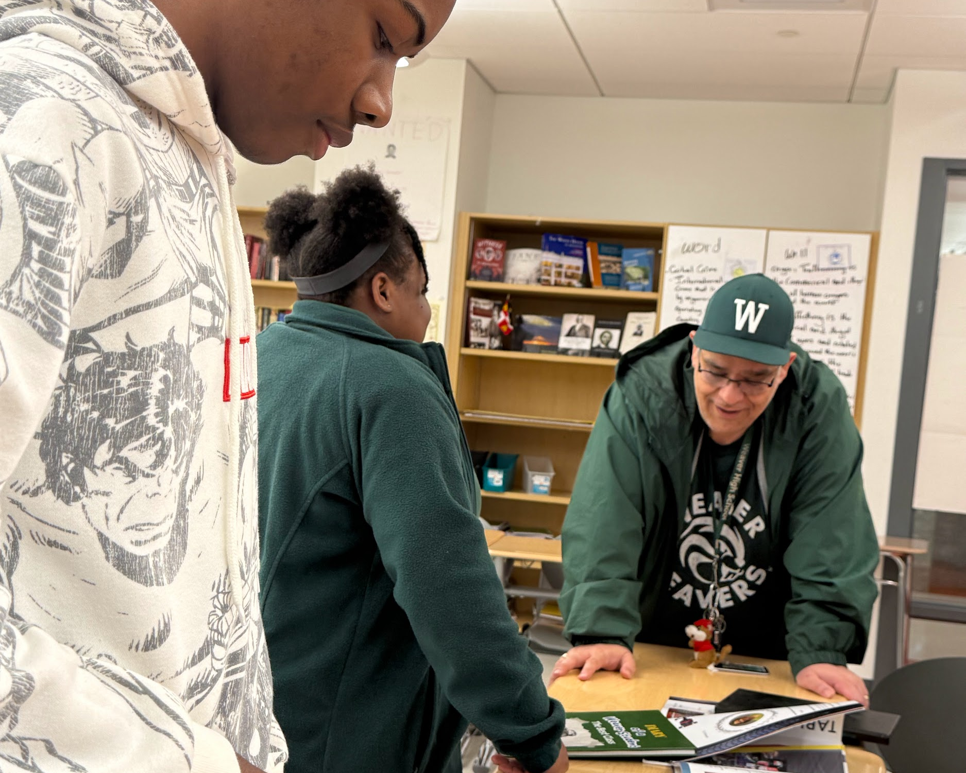
Advantages
Collaboration is easier
Quicker decision making
Brainstorming goes great
Fewer dramatic incidents

Slide 8
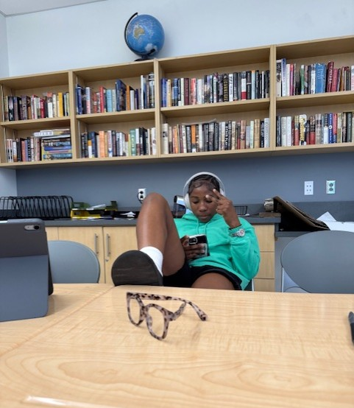
Don’t waste time
Set deadlines early
Make sure each meeting has an agenda with goals
Remind the team of deadlines regularly
Plan picture schedules early
Get schedule of events early

Slide 9
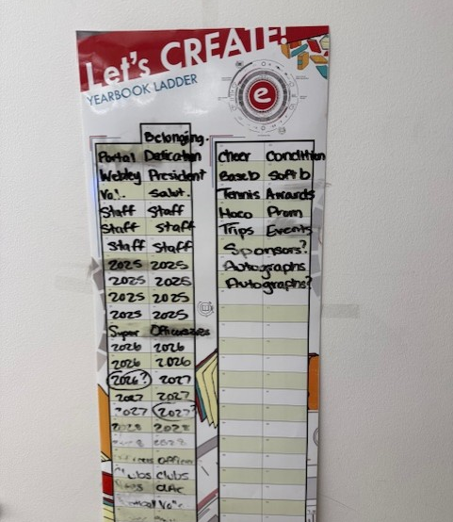
Use the Planner
Entourage has a planner
We used it to outline how the book should look
It helped with assignments and tracking
The crew knew what to do
They could check what needed to be done

Slide 10

Group Chat
Use Remind, GroupMe to keep in touch
Discuss outside of sessions
Crew would bounce ideas off each other
Some students preferred regular emails
Communicate instructions and requests for help
Set boundaries

Slide 11
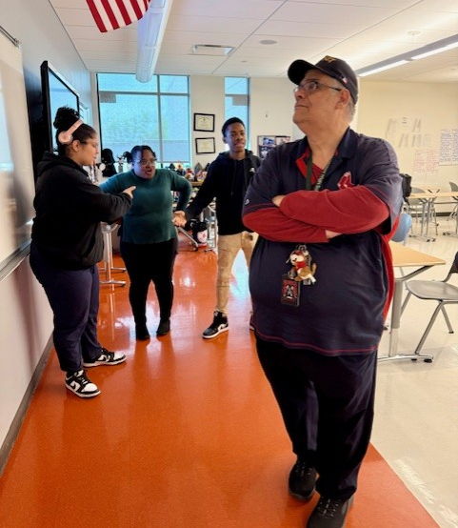
Listen to your crew
This is their yearbook
There were many times I had a vision for the yearbook
They disagreed
I let them run with it
They debated it
Book came out better

Slide 12
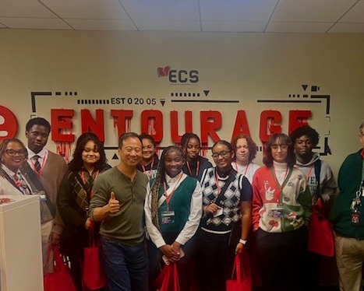
Reach out to Entourage
Entourage has many resources
Help Videos
Account Manager was very helpful
We even did a trip down there

Slide 13
Importance of the Editor
Editor keeps everyone on tasks
Many times she would write the content herself
Designed the templates
Planned out the agendas
Pick the strongest personality on your crew

Slide 14
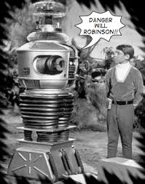
Be Careful!
Be Careful with who has access
Make sure members of your crew have the appropriate access
Check the ladder regular
Double check before you submit for production
Learned this the hard way

Slide 15

Set Deadline Early
Set the Deadline early
Work Backwards from it and plan from there
First deadline is the cover
Set up your planner and keep focused

Slide 16
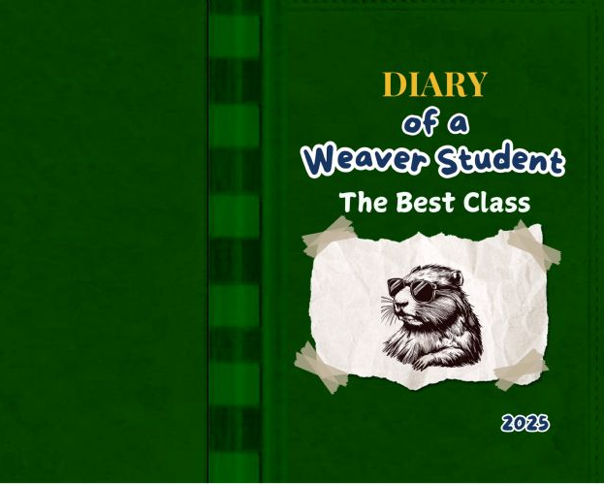
Theme
One of the first tasks is to choose a theme
Easier when crew is small
Hulu to Whimpy Kid
Allow students to brainstorm ideas
Theme throughout the book

Slide 17

Assign Roles
Make sure everyone knows their job
Editor
Photographer
Writer
Sales
Important in small group

Slide 18

Google Drive
Everyone can be a photographer
Create a Google Drive
Allow crew to upload photos and designs
Crew can review before uploading to yearbook
We had over 500 images before we started uploading
Shared with teachers so they could upload too

Slide 19
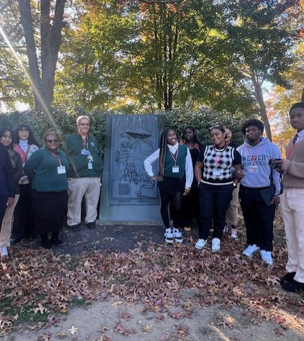
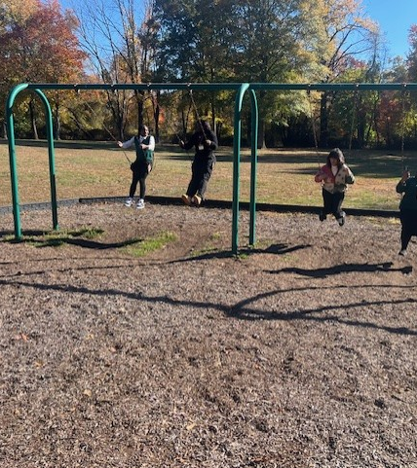
Have Fun
The Yearbook is a lot of Work
Take time to show your crew that you appreciate them
When time permits, do some fun activities
Let them be kids
This will allow them to blow off steam

Slide 20

Don’t be the boss
You are the facilitator not the dictator
This is their yearbook
Give direction but not orders
Allow them to make mistakes but keep them focused on the deadlines
Provide resources and expertise
Be the go-between with others when necessary

Slide 21
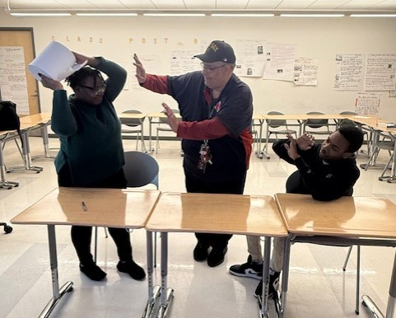
Be ready to solve disputes
Even with small crew, there will be disagreements
Be ready to step in
Sometimes all it takes is to remind them they have a job to
Most likely its conflicting vision
Sometimes it's the stress

Slide 22
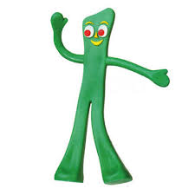
Be flexible
You have to be ready to change
We had to change direction many times
Your crew will count on you
Make sure that you don’t show the stress
Make it into a learning experience for them

Slide 23
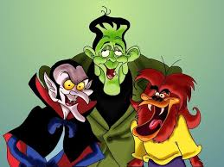
Lets hear your horror stories
https://padlet.com/canea001/what-are-some-of-the-problems-you-are-having-with-your-small-az3kxetlwstevetv

Slide 24

Tips for my crew

